Slide 1

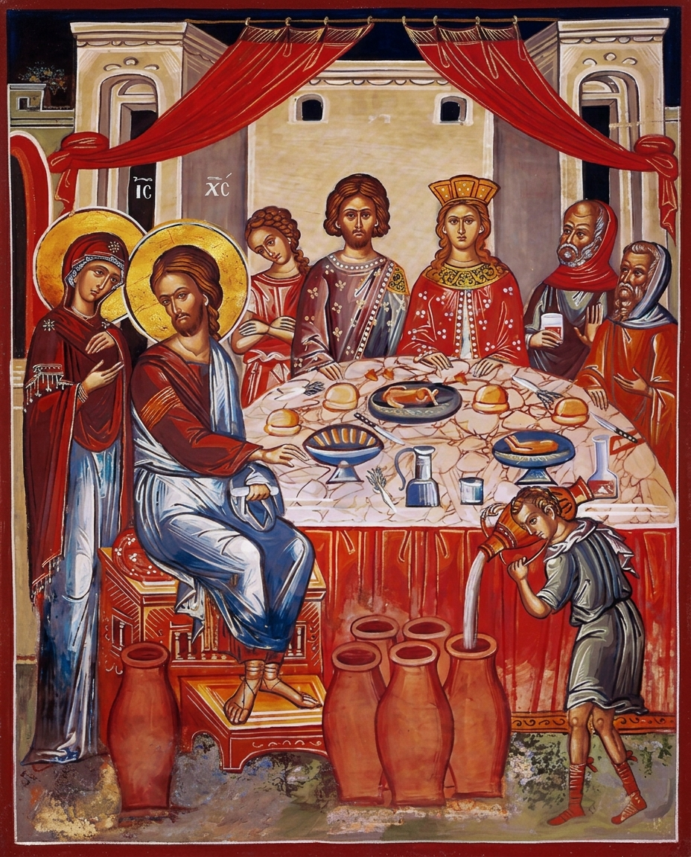
COMMUNITY OF THE MOTHER OF JESUS • ANNUAL GATHERING 2026
Do Whatever He Tells You
DEI as Mary’s Way of Discipleship & Service
“His mother said to the servants, ‘Do whatever He tells you.’” — John 2:5
LIVING OUR VOWS OF JUSTICE • TENDERNESS • HUMILITY • CONTEMPLATION

Slide 2
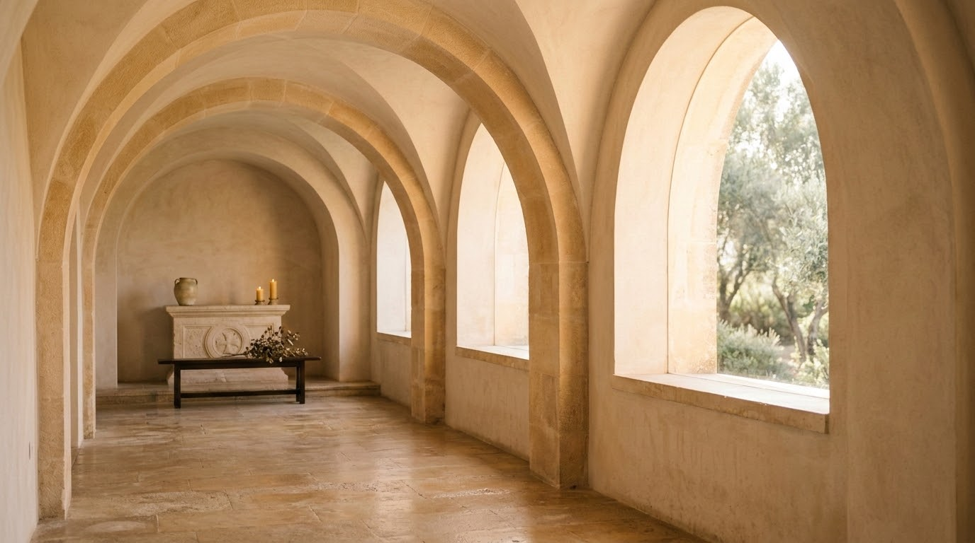


GATHERING COVENANT
Our Sacred & Brave Space
Holy Curiosity
Tenderness & Grace
Contemplation
Hybrid Equity
Deep listening over defense.
Goodwill with loving accountability.
Sacred pause before speaking.
Equal presence across spaces.

Slide 3
PATHWAY
What We Seek to Discern Today
01
Ground in Sacred Tradition
Reclaim DEI through Liberation Theology, Vatican II, and the Gospel mandate of Jesus Christ.
02
Read Between the Lines
Apply the Hermeneutics of Suspicion to Gospel parables and contemporary community life.
03
Commit to Consecrated Service
Formulate tangible, equitable actions aligned with our Rule of Life.

Slide 4
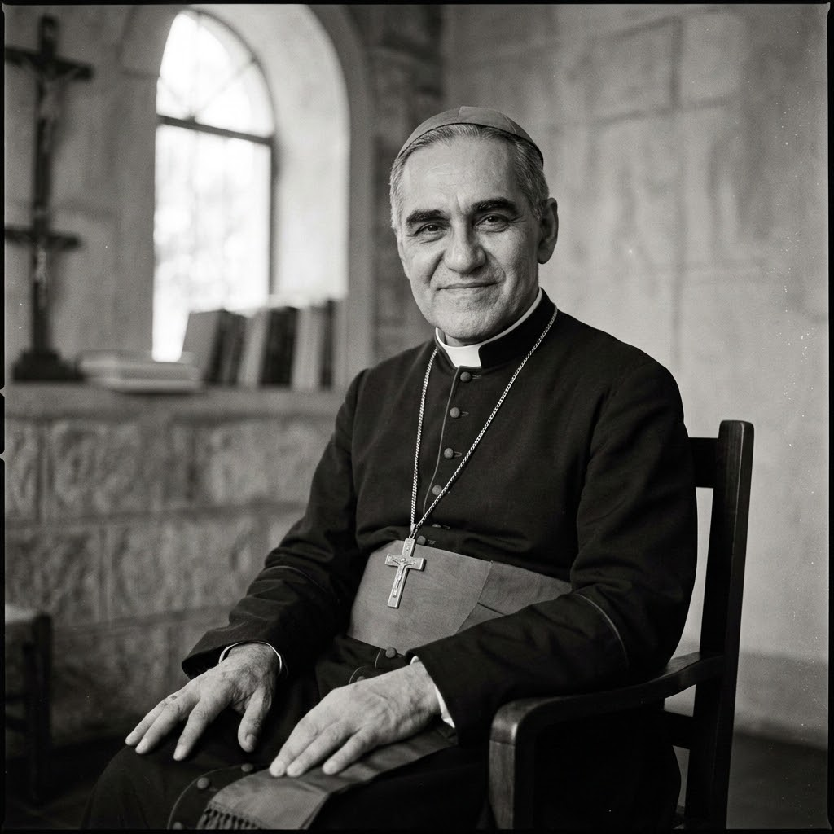
FOUNDATIONS
The Prophetic Root: Preferential Option of the Poor
The Theological Shift
Breaking centuries of preaching passive endurance; declaring that poverty and exclusion are sinful human structures, not divine will.
Vow of Justice
Prophetic solidarity with the dispossessed.
"There comes a point where we need to stop just pulling people out of the river. We need to go upstream and find out why they're falling in." -Bishop Desmond Tutu
Scriptural Mandate
“God chose what is foolish in the world to shame the wise; God chose what is weak in the world to shame the strong.”
— 1 Corinthians 1:27
“The Spirit of the Lord is upon me, because he has anointed me to bring good news to the poor... to proclaim liberty to captives and let the oppressed go free.”
— Luke 4:18–19 (citing Isaiah 61)
ST. OSCAR ROMERO
Voice of the Voiceless

Slide 5
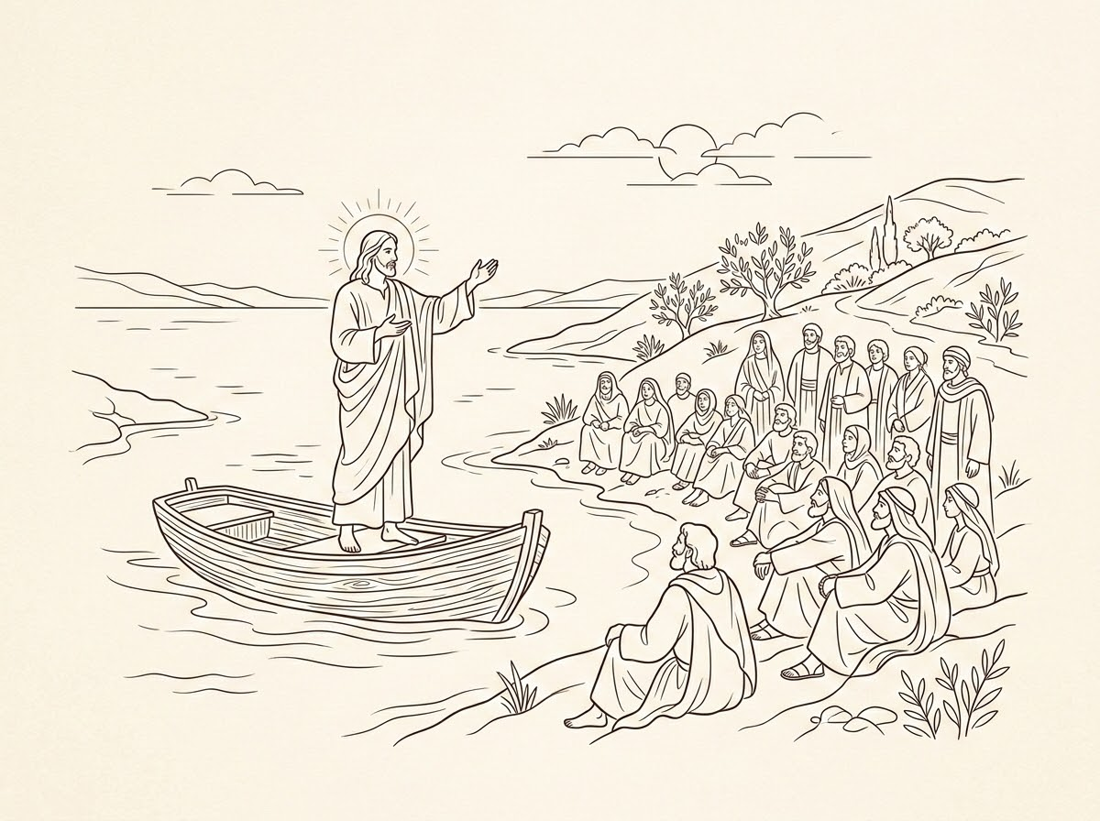
METHOD
Reading Between the Lines With Holy Curiosity
What is it? A liberative theological tool that questions surface readings to uncover systemic realities and hidden dynamics.
Steps:
I
II
III
The Unheard Voice
The Hidden Margin
Unexamined Norms
Whose presence was omitted?
Who stood outside the gates?
What assumptions built the wall?

Slide 6
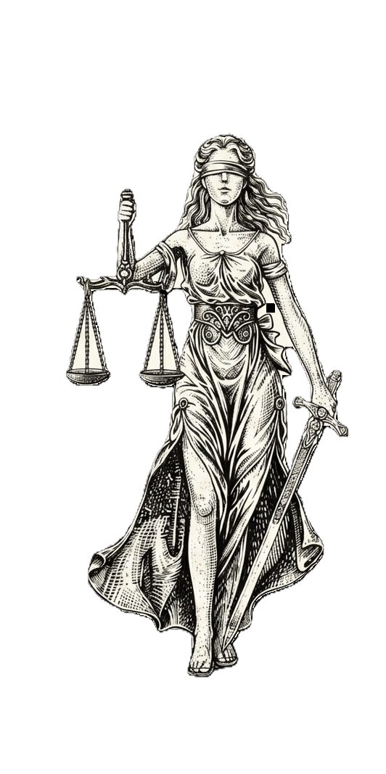
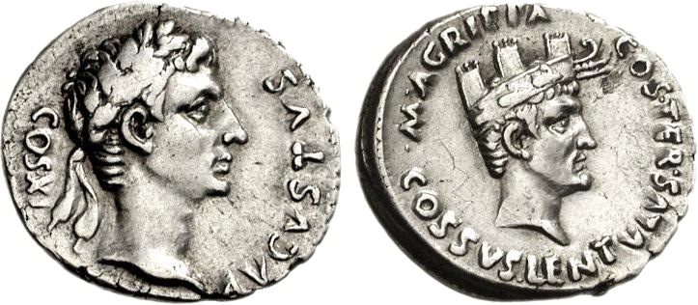
KINGDOM GLOSSARY
Reclaiming the Language of Belonging
1 COR 12:12
ACTS 4:34
ROMANS 15:7
ISAIAH 58:6
The Sacred Mosaic
Needs-Based Dignity
The Radical Table
Righteousness & Justice
Diversity as holy gift.
Equity ensuring the full denarius.
Inclusion centering the margin.
Making people whole so that all may become equal.
Vow of Contemplation
Vow of Justice
Vow of Humility
Concept of Liberation

Slide 7

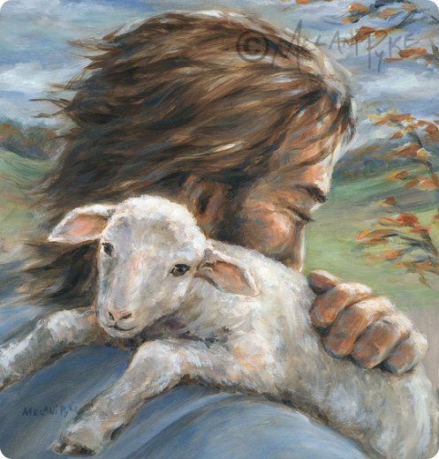
SCRIPTURE PROCLAMATION • LUKE 15:3-7
The Parable of the Lost Sheep
“So he told them this parable: ‘Which one of you, having a hundred sheep and losing one of them, does not leave the ninety-nine in the wilderness and go after the one that is lost until he finds it?
When he has found it, he lays it on his shoulders and rejoices. And when he comes home, he calls together his friends and neighbors, saying to them, “Rejoice with me, for I have found my sheep that was lost.”
Just so, I tell you, there will be more joy in heaven over one sinner who repents than over ninety-nine righteous persons who need no repentance.’”
Listen with the ear of the heart.

Slide 8

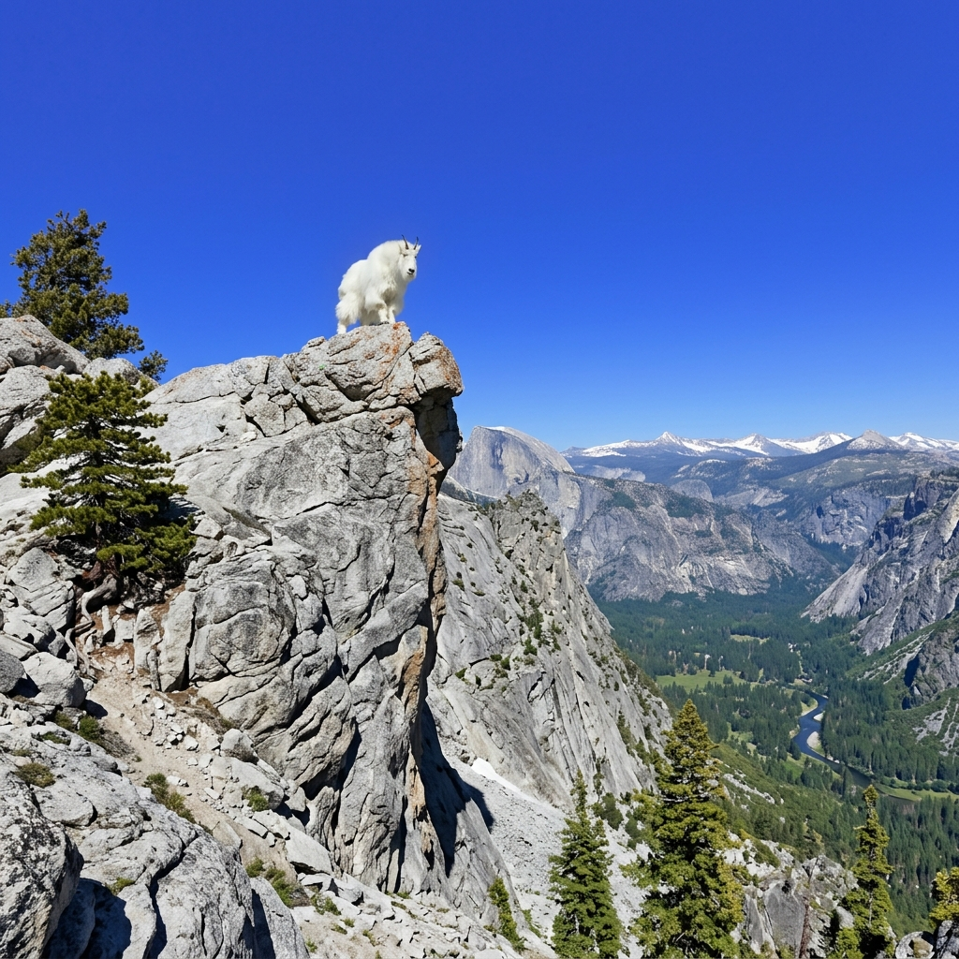
THEOLOGICAL DECONSTRUCTION
The Shepherd’s Bias: Deconstructing Luke 15
THE GRAZING 99
The Designed System
Comfort inside dominant structures.
Pace accommodated the privileged.
THE STRANDED ONE
Structural Barrier
Steep terrain created isolation.
Vow of Tenderness: leaving comfort to carry.

Slide 9
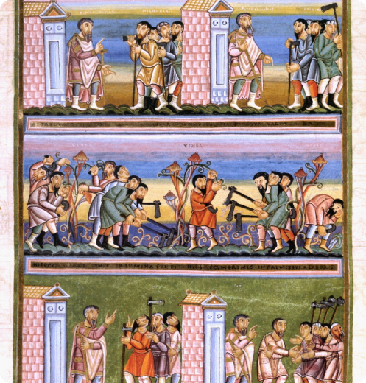
SCRIPTURE PROCLAMATION • MATTHEW 20:1-16
The Workers in the Vineyard
“‘For the kingdom of heaven is like a landowner who went out early in the morning to hire laborers for his vineyard... When he went out about nine o’clock, he saw others standing idle in the marketplace; and he said to them, “You also go into the vineyard.”’
‘...And about five o’clock he went out and found others standing around; and he said to them, “Why are you standing here idle all day?” They said to him, “Because no one has hired us.” He said to them, “You also go into the vineyard.”’
‘When evening came... those hired about five o’clock came, and each received the full day’s wage [a denarius]... The landowner answered: “Friend, I am doing you no wrong... Am I not allowed to do what I choose with what belongs to me? Or are you envious because I am generous?” So the last will be first, and the first will be last.’”
Needs-based justice over market merit.

Slide 10
GOSPEL ECONOMICS
Equity Over Transactional Merit
"Why have you been standing here idle all day?"
"...Because no one hired us."
MARKET EQUALITY
KINGDOM EQUITY
1/12th Denarius
The Full Denarius
Transactional output leaves families hungry.
Human sustenance and flourishing guaranteed.
Bypassed by systemic bias.
Vow of Justice: dignity untied from output.

Slide 11

PARTICIPATORY PRACTICE
Parallel Discernment: Applying the Hermeneutics of Suspicion
Scenario A
Scenario B
Sensory & Hybrid Hospitality
Spiritual Belonging & Welcome
Dismantling historic retreat architecture barriers.
Moving from detached charity to accompaniment.

Slide 12
SACRED VOCABULARY
Consecrated Communication Examples
Deficit-Based Framing | Consecrated Framing
The disabled member | Member living with a disability
Wheelchair-bound | Person who uses a wheelchair
Special needs accommodations | Equitable access requirements
Virtual observers | Online members in full fellowship

Slide 13

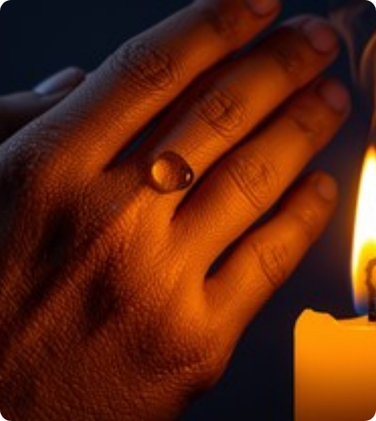
RULE OF LIFE
In the Rule of Life, quiet contemplation is where learning transforms into consecrated action.
Contemplation into Action
1. Concrete Barrier Removal
Dismantling one barrier in ministry.
2. Radical Hospitality
Centering marginalized voices with agency.

Slide 14
COMMISSIONING
Collect of Our Lady of Cana
Lord Jesus Christ, Shepherd of the Lost and Generous Landowner:
Grant us the Tenderness to seek out the forgotten,
The Justice to ensure every laborer receives the denarius of dignity,
The Humility to read between the lines with holy curiosity,
And the Contemplation to abide in Your transforming grace.
“Do whatever He tells you.” • Amen.

Slide 15





Image Sources
https://cdn11.bigcommerce.com/s-8npwm6ltcj/images/stencil/1280x1280/products/140/398/F188-legacy-icons__32955.1748138205.jpg?c=1&imbypass=on
Source: legacyicons.com
https://i.etsystatic.com/5949659/r/il/1dde15/3643862712/il_1080xN.3643862712_cpjk.jpg
Source: www.etsy.com
https://asf-cloudinary-backup.s3.us-east-1.amazonaws.com/res/decosites/image/upload/gwflufj7mv9v4yhktxfx/1702736183.jpg
Source: www.robbiegeorgephotography.com
https://blogger.googleusercontent.com/img/b/R29vZ2xl/AVvXsEiJNv3_uxDwQ_J_Py37yg8oKr3esnJ53IamT2Pa_eW7pHXP6MebWTL7uPLdUtbE8UrRR8J7YL-4ovt_8gCtWZW-FkvfAafgR5cjD4A8smSkLMORYzFKRLYtnvrcGutEakf9A3A56A7Zjxpr9MgnhUaafIN9n31nIBbkWtvmN4lmclG6htGA1z4atG9RIqo/s2411/1030_From%20the%20Codex%20Aureus%20of%20Echternach_German,%20c.%201030-1050_Nuremberg,%20Germanisches%20Nationalmuseum_MS%20Hs%20156%20142,%20fol.%2076v.jpg
Source: imaginemdei.blogspot.com
https://images.stockcake.com/public/d/3/4/d349f436-0ca6-48c4-bd3d-ba97a315b16b_medium/amber-prayer-glow-stockcake.jpg
Source: stockcake.com

